Slide 1

What the Hack?!
Challenge Format
How to Plan & Host
Peter Laudati
Gino Filicetti
CSA – US OCP Team
CSA – National CSA Team

Slide 2
What The Hack Here’s what you need to know!
“What the Hack” is a challenge based hackathon format
Challenges describe high-level tasks and goals to be accomplished
Challenges are not step-by-step labs.
Attendees work in teams of 3 to 5 people to solve the challenges
Attendees “learn from” and “share with” each other.
By having to “figure it out”, attendee knowledge retention is greater
Proctors provide guidance, but not answers to the teams
Emcees provide lectures & demos to setup challenges & review solutions
What the Hack can be hosted in-person or virtually via MS Teams

Slide 3
What The Hack So you want to host a Hack? Here’s what you need:
Hack Hosts
Content Owner/Emcee
Proctors
1 per 2 attendee teams if in-person
1 per attendee team if virtual
Hack Attendees
Teams of 3-5 ppl
2 MS Teams
1 for the hosts
1 for the attendees
Git repo to share all content post-event (not before/during!)

Slide 4
Content Owner Responsibilities
Pick a challenge scenario to be used for your hack
Look for existing content that can be repurposed for this format
Validate that the challenges for your scenario are accomplishable
Deliver track “content”:
Challenge List (document – 1-3 sentences/bullets with expectations)
Proctor’s guide (document – see Proctor Guide slide)
(Optional) Presentation with lecture slides if emcee or proctors want to demo/explain key concepts before/between challenges
(Optional) Pre-staged challenge content (pre-configured VM images, sample code)
Nominate an emcee for your hack
Ideally, the content leads should emcee, but if not, you can nominate someone else.
Help train/brief the Proctors on the challenges before the event

Slide 5
Challenge List Guidelines
Challenges should be cumulative, building upon each other
Establish Confidence – start small and simple (think hello world)
Build Competence – by having successively more complex challenges
Each challenge should provide educational value.
For example, if an attendee completes only 3 out of 7 challenges, he/she still walks away feeling satisfied that he/she has learned something
Think through what skills/experience you want attendees to walk away with by completing each challenge
Challenge definitions should be short. A couple of sentences or bullet points stating the end goal(s) and perhaps a hint at the skill(s) needed
Include a “Challenge 0” that has pre-requisites for workstation environment

Slide 6
Proctor’s Guide Guidelines
Proctor’s guide should have:
List of high-level steps to the challenge answers/solutions
List of known blockers (things attendees will get hung up on) and recommended hints for solving them
List of key concepts that should be explained-to/understood by attendees before a given challenge
Estimated time for each challenge (NOT to be shared with attendees)
Suggested time a proctor should wait before helping out if a team is not progressing past known blockers
Proctor’s guide may optionally have:
Pre-requisites for the Azure environment if needed.
Example: A VM image with Visual Studio or ML tools pre-installed.
Example: An ARM template and/or script that builds out an environment that saves time on solving a challenge
Slides that proctors can reference to help when teaching a key concept
Scripts/templates/etc for some challenges that can be shared with attendees if they get really stuck
Example: If challenges 1-3 build something (i.e. an ARM template) that is needed for challenge 4, you could “give” a stuck team the template so they could skip to challenge 4.
List of reference links/articles/documentation that can be shared when attendees get stuck
Proctor’s guide should be updated during & post event with key learnings on what worked, didn’t work, and unexpected blockers that came up.

Slide 7
Presentation Lecture (Optional) Guidelines
Event kickoff slides covering logistics & event format
Brief overview of challenge scenario & technology
Brief overviews of concepts needed to complete challenges
Try to keep lectures <10 minutes per challenge
Slides with Challenge definitions that can be displayed when attendees are working on challenges
Review of each challenge’s solution to be presented after challenge completion

Slide 8
Emcee Responsibilities
Emcee will anchor the room and handle announcements, etc.
i.e. The person with the skinny microphone!
Emcee will also help huddle the proctors if they need to share info during the event.
Emcee will present any content to prep the attendees (event intro, logistics, mini-tech lectures, demos, etc)
Emcee will maintain list of unexpected blockers (and their solutions) that come up during the event. These blockers should:
Be recorded live to the proctor’s guide and used by the content leads for future events
Communicated to the attendees in the room.
Emcee is responsible for helping attendees form teams.
If in-person, this can be driven based on the tables people sit at or balanced by skill set/levels
If virtual, randomly nominate team leads, and have the leads pick teammates (like in gym class!)
Emcee will constantly solicit feedback throughout the event!

Slide 9
Proctor Responsibilities
Keep the teams working as teams!
Encourage all to “learn from” and “share with” each other!
If you observe individuals racing ahead, encourage them to help those who are behind.
Encourage attendees to use their team’s channel on MS Teams to collaborate/share info!
Unblock teams who get stuck
Encourage team members to unblock each other first!
Provide hints, but not answers
If you observe individuals stuck for a while, help them get moving so they don’t lose interest.
Provide hints/pointers to the teams on how to solve problems & where to find information.
Use the answers/solutions in the proctor’s guide, but don’t share with the attendees
Proctor’s guide won’t be comprehensive. As SMEs, proctors should use their knowledge to help with solution hints/ideas.
Notify the emcee of unexpected blockers that arise during the event so they can be communicated to all, and recorded for future reference.

Slide 10
Hack Attendees Responsibilities
Learn
Do
Learn
Share
NOTE: Attendees should not be judged on how far they get. No trophies should be given for challenge completion. If event hosts want to gamify/incentivize attendees, they should focus on encouraging attendees to share with each other!

Slide 11
Using MS Teams Hack Hosts - Proctors & Event Staff
A private “Hack Hosts” MS Team should be created for the event.
All hosts (proctors, emcees & event staff) are added to the MS Team before event
If there are multiple hack tracks, a channel should be created for each hack track
All proctor’s guides should be loaded into the channel for that track as a tab.
Proctors will use teams to access the proctor guide during the event.
Any other optional resources for the proctors will be stored in the Files tab (slides, templates, etc)
Proctors should communicate with each other privately from attendees to share learnings/practices during the event.
Proctors and emcees can work together to decide if/when to communicate issues broadly to all attendees during the event.

Slide 12
Using MS Teams Hack Attendees
A “Hack Attendees” MS Team will be created for the event.
If an in-person hack, attendees should be instructed to join the MS Team at event kick off
If a virtual hack, attendees should be added to the MS Team before the event based on registration
Each table/team should create their own Channel to share info during the event (code snippets, links, references, screen sharing, etc)
The event’s “General” channel will have tabs containing the Challenges & “Shared Tips”
Challenges tab will be posted by the content owners
“Shared Tips” is open to any proctor/attendee/team to share knowledge broadly to all teams. Since the event is not competitive, sharing SHOULD be encouraged!
There is also a “Feedback” channel for live event feedback.

Slide 13
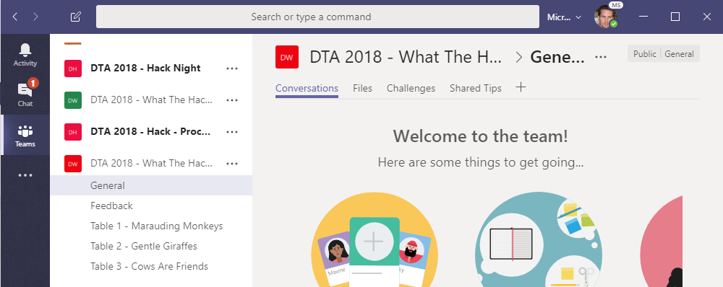
Using MS Teams Hack Attendees Example
Hang out, communicate, talk, and screenshare with squad members in your squad’s channel
DURING & after the event, share feedback with the proctors in the Feedback channel. This will help them improve the event as it progresses and make the next one even better
Find any files, resources, or code samples, and THIS presentation here!
Challenges will be posted here by the proctors throughout the event
Share tips, tricks, gotchas (how you solved them), code snippets, and links you learn along the way here with everyone

Slide 14
GitHub Repo Guidelines
All hack content should be contributed to the What The Hack GitHub repo for sharing post-event
https://github.com/Microsoft/WhatTheHack
The repo should NOT be shared with attendees before or during the event (because it will have the answers!)
Attendees should be encouraged to re-use the content to train others
Instructions on how to contribute to the What The Hack GitHub repo and how to structure your files are available in a separate document.

Slide 15
Thanks! We hope you have a successful What the Hack event!!!

